Slide 1

EVERYTHING DiSC® SALES
SAMPLE

Slide 2
Program Overview
Everything DiSC ® Sales
SAMPLE
Understanding Your DiSC® Sales Style
Recognizing and Understanding Customer Buying Styles
Adapting Your Sales Style to Your Customer’s Buying Style

Slide 3
Section I:
Understanding Your DiSC® Sales Style
SAMPLE
Module 1

Slide 4

Connecting to Our Customers
SAMPLE
Find ourselves
Find our customers
Navigate to
our customers

Slide 5


Strengths and Challenges
Strengths
Challenges
SAMPLE
Write an example for each strength and challenge

Slide 6
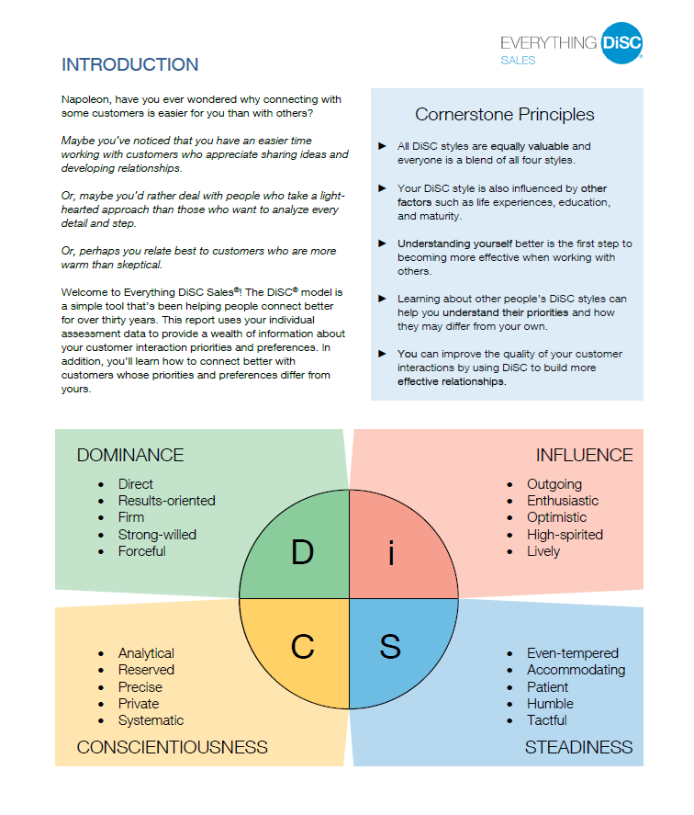
Introduction to Everything DiSC®
Everything DiSC
Sales Profile
Page 2 Introduction to DiSC®

Slide 7
Welcome to Everything DiSC®
Profile, Page 2
Table discussion
SAMPLE
What got your attention?
Importance of the cornerstone principles

